Slide 1




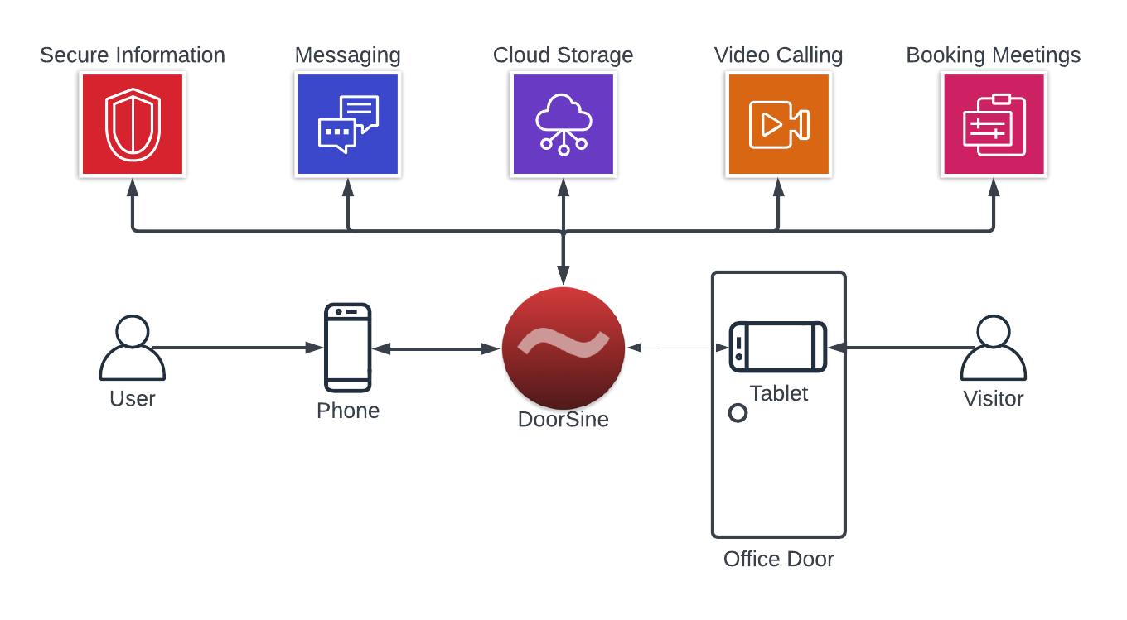







DoorSine™
Knut Sander Blakkestad with Dr. Shoaib Jameel
Innovative, Intelligent and Industry Ready
Not sure if I like this text, but unsure what to have here

